Slide 1
Punctuation Styles

Slide 2
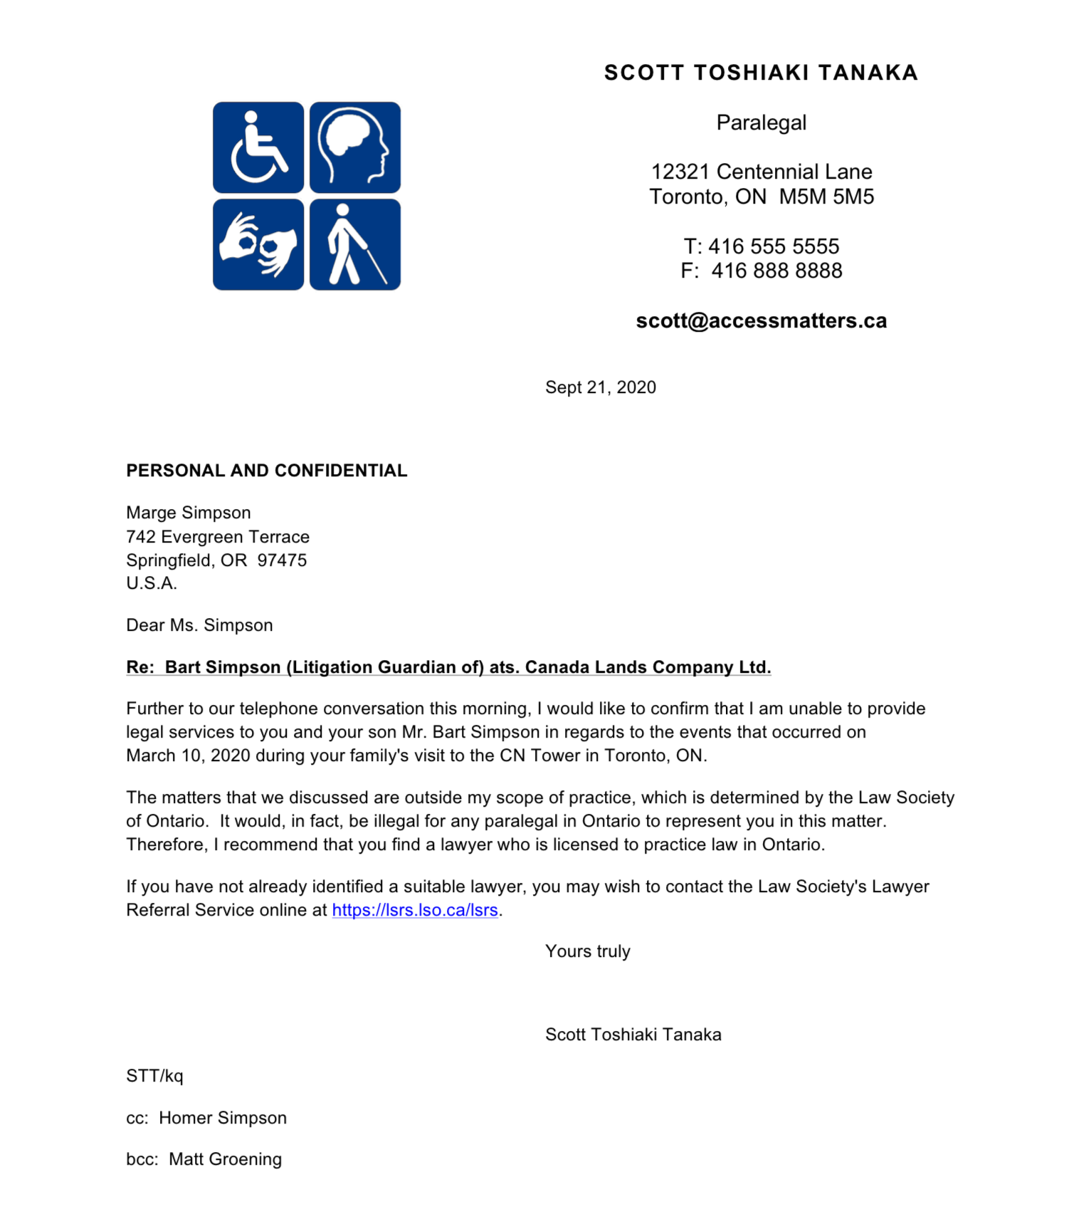


Slide 3
Open punctuation
It stands for the omission of characters and marks such as full stops (periods), colons, or commas in the address, after the salutation, in abbreviations, etc. in English correspondence.
Developed from today’s age of electronic messaging
Newer and more practical
Minimalistic

Slide 4
Examples
Dear Mr Abraham
2 March 2010
ABC Corporation
ABC Street
Townville KY 40243

Slide 5
Closed punctuation
The use of commas or periods (full stops) after the salutation, the complimentary close, in abbreviations, etc.

Slide 6
Examples
Dear Sally,
Mr. Jason Richardson

Slide 7
Mixed Punctuation
The bridge between open and closed punctuation. You will add a colon after the salutation and a comma after the closing line.

Slide 8
Examples
Dear Mr. Frazier:
[Body of letter]
Sincerely,
(your name)

Slide 9
Punctuation Styles
Closed punctuation
Parts of heading, date, inside address, salutation and complimentary close are punctuated.
Standard punctuation
No line of heading or inside address is punctuated. After salutation and complimentary close a comma is placed.
Open punctuation
It requires no punctuation even after the salutation and the complimentary close.

